Slide 1
White Box Testing

Slide 2
Organization of this Lecture
Introduction to Testing.
White-box testing:
  statement coverage
  path coverage
  branch testing
  condition coverage
  Cyclomatic complexity
Summary

Slide 3
White-Box Testing
There exist several popular white-box testing methodologies:
  Statement coverage
  branch coverage
  path coverage
  condition coverage
  mutation testing

Slide 4
Statement Coverage
Statement coverage methodology:
  design test cases so that
    every statement in a program is executed at least once.

Slide 5
Statement Coverage
The principal idea:
  unless a statement is executed,
  we have no way of knowing if an error exists in that statement.

Slide 6
Example
int f1(int x, int y){
1 while (x != y){
2 if (x>y) then
3 x=x-y;
4 else y=y-x;
5 }
6 return x; }
Euclid's GCD Algorithm

Slide 7
Branch Coverage
Test cases are designed such that:
  different branch conditions
    given true and false values in turn.

Slide 8
Branch Coverage
Branch testing guarantees statement coverage:
  a stronger testing compared to the statement coverage-based testing.

Slide 9
Example
int f1(int x,int y){
1 while (x != y){
2 if (x>y) then
3 x=x-y;
4 else y=y-x;
5 }
6 return x; }

Slide 10
Example
Test cases for branch coverage can be:
{(x=3,y=3),(x=3,y=2), (x=4,y=3), (x=3,y=4)}

Slide 11
Condition Coverage
Test cases are designed such that:
  each component of a composite conditional expression
    given both true and false values.

Slide 12
Example
Consider the conditional expression
  ((c1.and.c2).or.c3):
Each of c1, c2, and c3 are exercised at least once,
  i.e. given true and false values.

Slide 13
Condition testing
  stronger testing than branch testing:
Branch testing
  stronger than statement coverage testing.

Slide 14
Condition coverage
Consider a boolean expression having n components:
  for condition coverage we require 2^{n} test cases.

Slide 15
Path Coverage
Design test cases such that:
  all linearly independent paths in the program are executed at least once.

Slide 16
Linearly independent paths
Defined in terms of
  control flow graph (CFG) of a program.

Slide 17
Path coverage-based testing
To understand the path coverage-based testing:
  we need to learn how to draw control flow graph of a program.

Slide 18
Control flow graph (CFG)
A control flow graph (CFG) describes:
  the sequence in which different instructions of a program get executed.
  the way control flows through the program.

Slide 19
How to draw Control flow graph?
Number all the statements of a program.
Numbered statements:
  represent nodes of the control flow graph.

Slide 20
Example
int f1(int x,int y){
1 while (x != y){
2 if (x>y) then
3 x=x-y;
4 else y=y-x;
5 }
6 return x; }

Slide 21
Example Control Flow Graph
1
2
3
4
5
6

Slide 22
How to draw Control flow graph?
Sequence:
  1 a=5;
  2 b=a*b-1;
1
2

Slide 23
How to draw Control flow graph?
Selection:
  1 if(a>b) then
  2 c=3;
  3 else c=5;
  4 c=c*c;
1
2
3
4

Slide 24
How to draw Control flow graph?
1
Iteration:
  1 while(a>b){
  2 b=b*a;
  3 b=b-1;}
  4 c=b+d;
2
3
4

Slide 25
Path
A path through a program:
  a node and edge sequence from the starting node to a terminal node of the control flow graph.
  There may be several terminal nodes for program.

Slide 26
Independent path
Any path through the program:
  introducing at least one new node:
    that is not included in any other independent paths.

Slide 27
Independent path
It is straight forward:
  to identify linearly independent paths of simple programs.
For complicated programs:
  it is not so easy to determine the number of independent paths.

Slide 28
McCabe's cyclomatic metric
An upper bound:
  for the number of linearly independent paths of a program
Provides a practical way of determining:
  the maximum number of linearly independent paths in a program.

Slide 29
McCabe's cyclomatic metric
Given a control flow graph G,
cyclomatic complexity V(G):
  V(G)= E-N+2
    N is the number of nodes in G
    E is the number of edges in G

Slide 30
Example Control Flow Graph
1
2
3
4
5
6

Slide 31
Example
Cyclomatic complexity =
7-6+2 = 3.

Slide 32
Cyclomatic complexity
Another way of computing cyclomatic complexity:
  inspect control flow graph
  determine number of bounded areas in the graph
V(G) = Total number of bounded areas + 1

Slide 33
Bounded area
Any region enclosed by a nodes and edge sequence.

Slide 34
Example Control Flow Graph
1
2
3
4
5
6

Slide 35
Example
From a visual examination of the CFG:
  the number of bounded areas is 2.
  cyclomatic complexity = 2+1=3.

Slide 36
Cyclomatic complexity
McCabe's metric provides:
    a quantitative measure of testing difficulty and the ultimate reliability
Intuitively,
  number of bounded areas increases with the number of decision nodes and loops.

Slide 37
Cyclomatic complexity
The first method of computing V(G) is amenable to automation:
  you can write a program which determines the number of nodes and edges of a graph
  applies the formula to find V(G).

Slide 38
Cyclomatic complexity
The cyclomatic complexity of a program provides:
  a lower bound on the number of test cases to be designed
  to guarantee coverage of all linearly independent paths.

Slide 39
Cyclomatic complexity
Defines the number of independent paths in a program.
Provides a lower bound:
  for the number of test cases for path coverage.

Slide 40
Cyclomatic complexity
Knowing the number of test cases required:
  does not make it any easier to derive the test cases,
  only gives an indication of the minimum number of test cases required.

Slide 41
Path testing
The tester proposes:
  an initial set of test data using his experience and judgement.

Slide 42
Path testing
A dynamic program analyzer is used:
  to indicate which parts of the program have been tested
  the output of the dynamic analysis
    used to guide the tester in selecting additional test cases.

Slide 43
Derivation of Test Cases
Let us discuss the steps:
  to derive path coverage-based test cases of a program.

Slide 44
Derivation of Test Cases
Draw control flow graph.
Determine V(G).
Determine the set of linearly independent paths.
Prepare test cases:
  to force execution along each path.

Slide 45
Example
int f1(int x,int y){
1 while (x != y){
2 if (x>y) then
3 x=x-y;
4 else y=y-x;
5 }
6 return x; }

Slide 46
Example Control Flow Diagram
1
2
3
4
5
6

Slide 47
Derivation of Test Cases
Number of independent paths: 3
  1,6 test case (x=1, y=1)
  1,2,3,5,1,6 test case(x=1, y=2)
  1,2,4,5,1,6 test case(x=2, y=1)

Slide 48
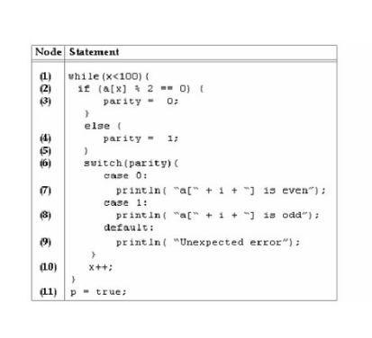


Slide 49
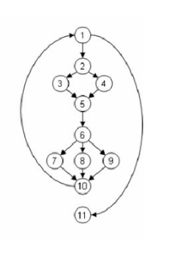

Slide 50
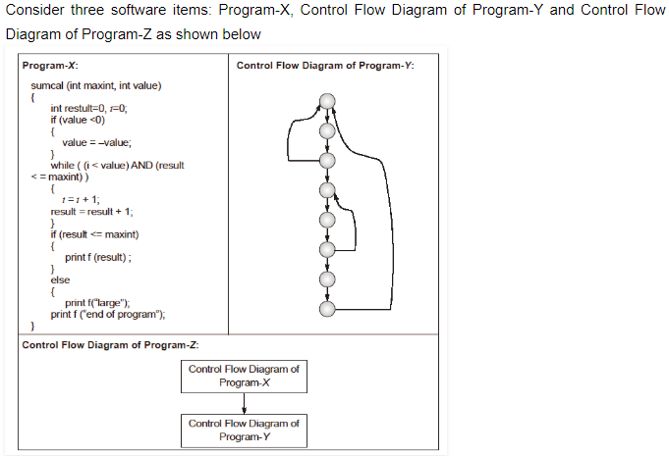

Slide 51
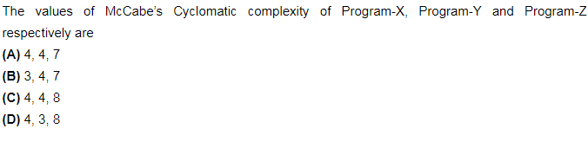



Slide 52
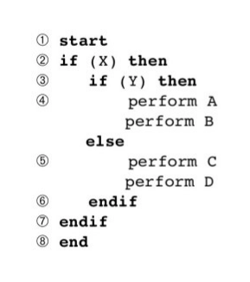
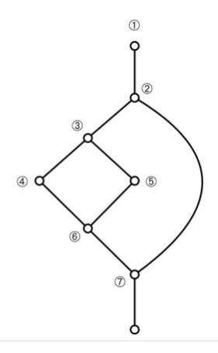

Slide 53
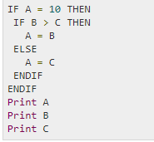

Slide 54
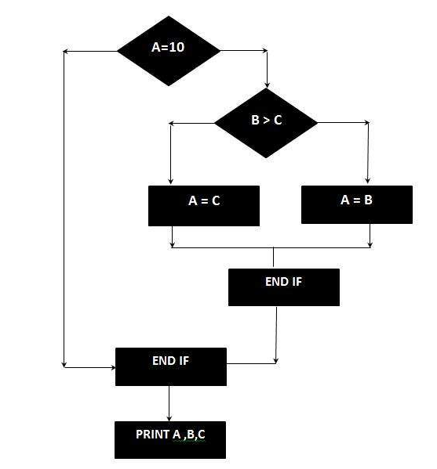

Slide 55
1 int functionY(void)
2 {
3 int x = 0;
4 int y = 19;
5 A: x++;
6 if (x > 999)
7 goto D;
8 if (x % 11 == 0)
9 goto B;
10 else goto A;
11 B: if (x % y == 0)
12 goto C;
13 else goto A;
14 C: printf("%d\n", x);
15 goto A;
16 D: printf("End of list\n");
17 return 0;
18 }

Slide 56
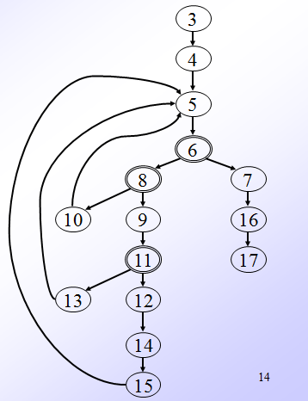

Slide 57
Example 2
1 int functionZ(int y)
2 {
3 int x = 0;
4 while (x <= (y * y))
5 {
6 if ((x % 11 == 0) &&
7 (x % y == 0))
8 {
9 printf(“%d”, x);
10 x++;
11 } // End if
12 else if ((x % 7 == 0) ||
13 (x % y == 1))
14 {
15 printf(“%d”, y);
16 x = x + 2;
} // End else
18 printf(“\n”);
19 } // End while
20 printf("End of list\n");
21 return 0;
22 } // End functionZ

Slide 58
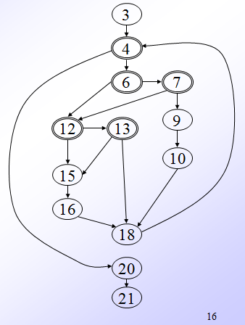

Slide 59
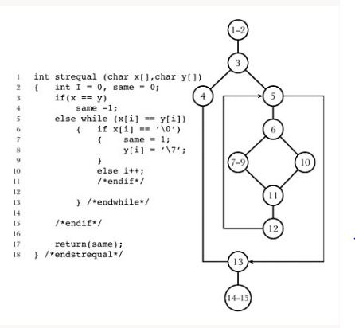

Slide 60
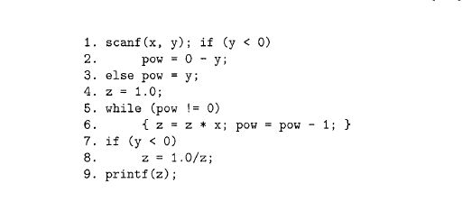

Slide 61
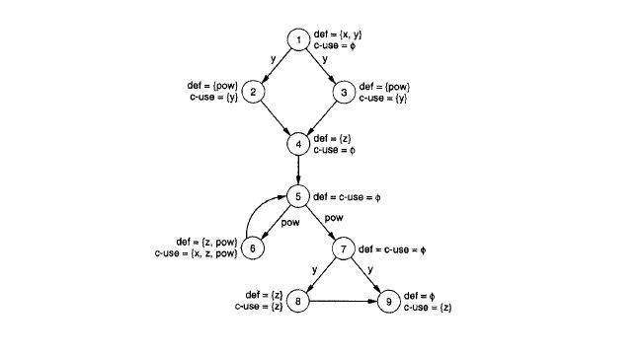

Slide 62
An interesting application of cyclomatic complexity
Relationship exists between:
  McCabe's metric
  the number of errors existing in the code,
  the time required to find and correct the errors.

Slide 63
Cyclomatic complexity
Cyclomatic complexity of a program:
  also indicates the psychological complexity of a program.
  difficulty level of understanding the program.

Slide 64
Cyclomatic complexity
From maintenance perspective,
  limit cyclomatic complexity
    of modules to some reasonable value.
  Good software development organizations:
    restrict cyclomatic complexity of functions to a maximum of ten or so.

Slide 65
Data Flow-Based Testing
Selects test paths of a program:
  according to the locations of
    definitions and uses of different variables in a program.

Slide 66
Data Flow-Based Testing
For a statement numbered S,
  DEF(S) = {X/statement S contains a definition of X}
  USES(S)= {X/statement S contains a use of X}
  Example: 1: a=b; DEF(1)={a}, USES(1)={b}.
  Example: 2: a=a+b; DEF(1)={a}, USES(1)={a,b}.

Slide 67
Data Flow-Based Testing
A variable X is said to be live at statement S1, if
  X is defined at a statement S:
  there exists a path from S to S1 not containing any definition of X.

Slide 68
DU Chain Example
1 X(){
2 a=5; /* Defines variable a */
3 While(C1) {
4 if (C2)
5 b=a*a; /*Uses variable a */
6 a=a-1; /* Defines variable a */
7 }
8 print(a); } /*Uses variable a */

Slide 69
Definition-use chain (DU chain)
[X,S,S1],
  S and S1 are statement numbers,
  X in DEF(S)
  X in USES(S1), and
  the definition of X in the statement S is live at statement S1.

Slide 70
Data Flow-Based Testing
One simple data flow testing strategy:
  every DU chain in a program be covered at least once.

Slide 71
Data Flow-Based Testing
Data flow testing strategies:
  useful for selecting test paths of a program containing nested if and loop statements

Slide 72
Data Flow-Based Testing
    1 X(){
    2 B1; /* Defines variable a */
    3 While(C1) {
    4 if (C2)
    5 if(C4) B4; /*Uses variable a */
    6 else B5;
    7 else if (C3) B2;
    8 else B3; }
    9 B6 }

Slide 73
Data Flow-Based Testing
[a,1,5]: a DU chain.
Assume:
  DEF(X) = {B1, B2, B3, B4, B5}
  USED(X) = {B2, B3, B4, B5, B6}
  There are 25 DU chains.
However only 5 paths are needed to cover these chains.

Slide 74
Mutation Testing
The software is first tested:
  using an initial testing method based on white-box strategies we already discussed.
After the initial testing is complete,
  mutation testing is taken up.
The idea behind mutation testing:
  make a few arbitrary small changes to a program at a time.

Slide 75
Mutation Testing
Each time the program is changed,
  it is called a mutated program
  the change is called a mutant.

Slide 76
Mutation Testing
A mutated program:
  tested against the full test suite of the program.
If there exists at least one test case in the test suite for which:
  a mutant gives an incorrect result,
  then the mutant is said to be dead.

Slide 77
Mutation Testing
If a mutant remains alive:
  even after all test cases have been exhausted,
  the test suite is enhanced to kill the mutant.
The process of generation and killing of mutants:
  can be automated by predefining a set of primitive changes that can be applied to the program.

Slide 78
Mutation Testing
The primitive changes can be:
  altering an arithmetic operator,
  changing the value of a constant,
  changing a data type, etc.

Slide 79
Mutation Testing
A major disadvantage of mutation testing:
  computationally very expensive,
  a large number of possible mutants can be generated.

Slide 80
Cause and Effect Graphs
Testing would be a lot easier:
  if we could automatically generate test cases from requirements.
Work done at IBM:
  Can requirements specifications be systematically used to design functional test cases?

Slide 81
Cause and Effect Graphs
Examine the requirements:
  restate them as logical relation between inputs and outputs.
  The result is a Boolean graph representing the relationships
    called a cause-effect graph.

Slide 82
Cause and Effect Graphs
Convert the graph to a decision table:
  each column of the decision table corresponds to a test case for functional testing.

Slide 83
Steps to create cause-effect graph
Study the functional requirements.
Mark and number all causes and effects.
Numbered causes and effects:
  become nodes of the graph.

Slide 84
Steps to create cause-effect graph
Draw causes on the LHS
Draw effects on the RHS
Draw logical relationship between causes and effects
  as edges in the graph.
Extra nodes can be added
  to simplify the graph

Slide 85
Drawing Cause-Effect Graphs
A
B
If A then B
A
B
C
If (A and B)then C

Slide 86
Drawing Cause-Effect Graphs
A
B
C
If (A or B)then C
A
B
C
If (not(A and B))then C

Slide 87
Drawing Cause-Effect Graphs
A
B
C
If (not (A or B))then C
A
B
If (not A) then B

Slide 88
Cause effect graph- Example
A water level monitoring system
  used by an agency involved in flood control.
  Input: level(a,b)
    a is the height of water in dam in meters
    b is the rainfall in the last 24 hours in cms

Slide 89
Cause effect graph- Example
Processing
  The function calculates whether the level is safe, too high, or too low.
Output
  message on screen
    level=safe
    level=high
    invalid syntax

Slide 90
Cause effect graph- Example
We can separate the requirements into 5 clauses:
  first five letters of the command is “level”
  command contains exactly two parameters
    separated by comma and enclosed in parentheses

Slide 91
Cause effect graph- Example
Parameters A and B are real numbers:
  such that the water level is calculated to be low
  or safe.
The parameters A and B are real numbers:
  such that the water level is calculated to be high.

Slide 92
Cause effect graph- Example
  Command is syntactically valid
  Operands are syntactically valid.

Slide 93
Cause effect graph- Example
Three effects
  level = safe
  level = high
  invalid syntax

Slide 94
Cause effect graph- Example
1
10
E3
2
11
3
E1
4
E2
5

Slide 95
Cause effect graph- Decision table
Test 1
Test 2
Test 3
Test 4
Test 5
Cause 1
I
I
I
S
I
Cause 2
I
I
I
X
S
Cause 3
I
S
S
X
X
Cause 4
S
I
S
X
X
Cause 5
S
S
I
X
X
Effect 1
P
P
A
A
A
Effect 2
A
A
P
A
A
Effect 3
A
A
A
P
P

Slide 96
Cause effect graph- Example
Put a row in the decision table for each cause or effect:
  in the example, there are five rows for causes and three for effects.

Slide 97
Cause effect graph- Example
The columns of the decision table correspond to test cases.
Define the columns by examining each effect:
  list each combination of causes that can lead to that effect.

Slide 98
Cause effect graph- Example
We can determine the number of columns of the decision table
  by examining the lines flowing into the effect nodes of the graph.

Slide 99
Cause effect graph- Example
Theoretically we could have generated 25=32 test cases.
  Using cause effect graphing technique reduces that number to 5.

Slide 100
Cause effect graph
Not practical for systems which:
  include timing aspects
  feedback from processes is used for some other processes.

